Slide 1
Autoregressive Models

Slide 2
Autoregressive models
Autocorrelation
Stationarity
Differencing
The autoregressive (AR) process
The moving average (MA) process
The ARIMA model

Slide 3
Autocorrelation

Slide 4
Autocorrelation
Autocorrelation, also known as serial correlation, represents the correlation between a time series and a delayed version of itself.
The delayed variables are also called lags.

Slide 5
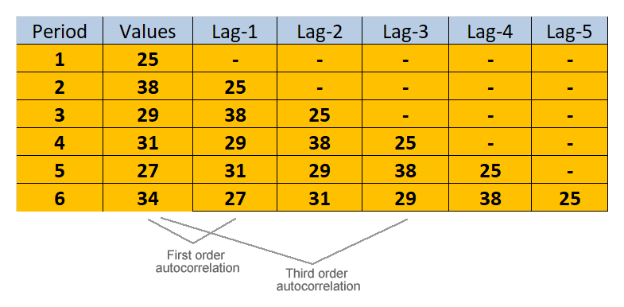
Autocorrelation

Slide 6
Autocorrelation
The presence of autocorrelation in a series can help us improve forecasts. For example:
a positive autocorrelation means that successive values in our series are similar
a negative autocorrelation means that successive values tend to be different

Slide 7
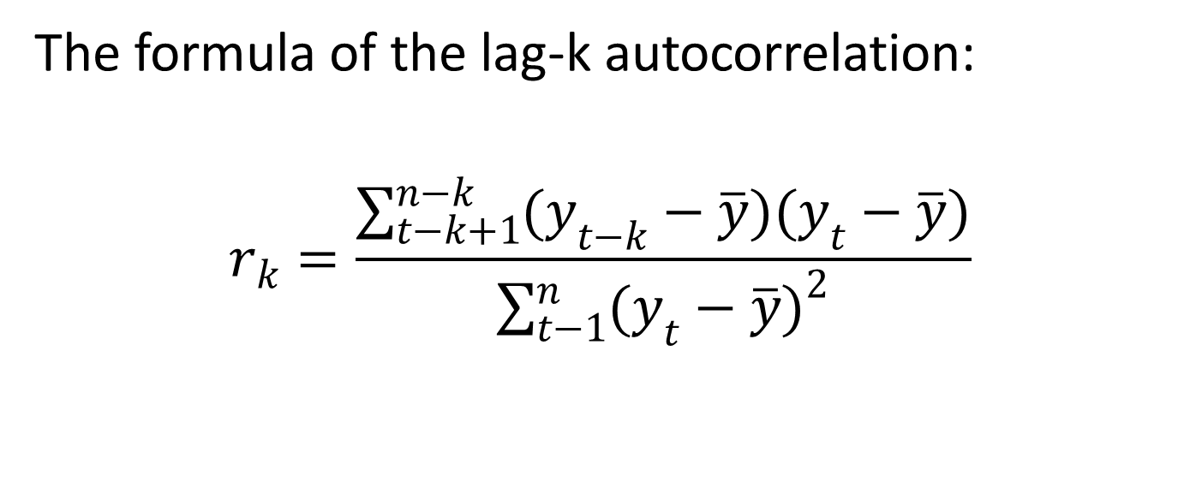
Autocorrelation
The formula of the lag-k autocorrelation:
$$r_{k}=\frac{\sum_{t−k+1}^{n−k}{(y_{t−k}−\overline{y})(y_{t}−\overline{y})}}{\sum_{t−1}^{n}{{(y_{t}−\overline{y})}^{2}}}$$

Slide 8
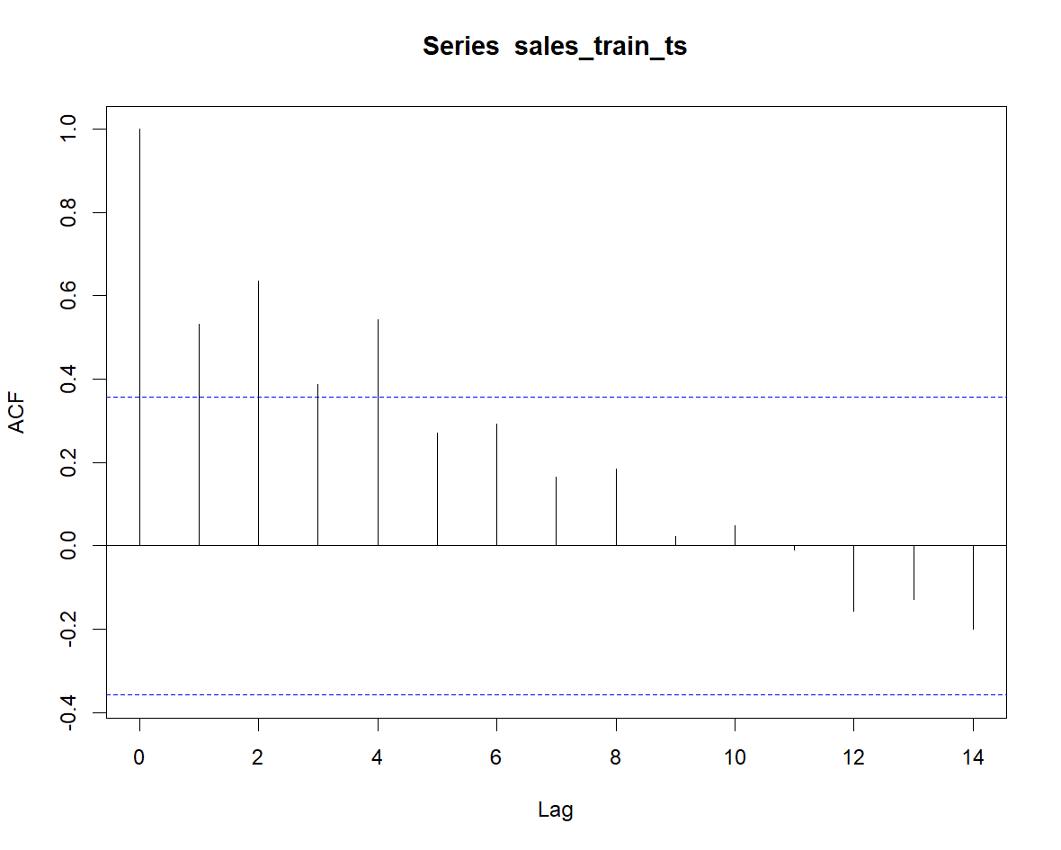
Autocorrelation
To visualize autocorrelation at various lags, we can use a special function called autocorrelation function (ACF).

Slide 9
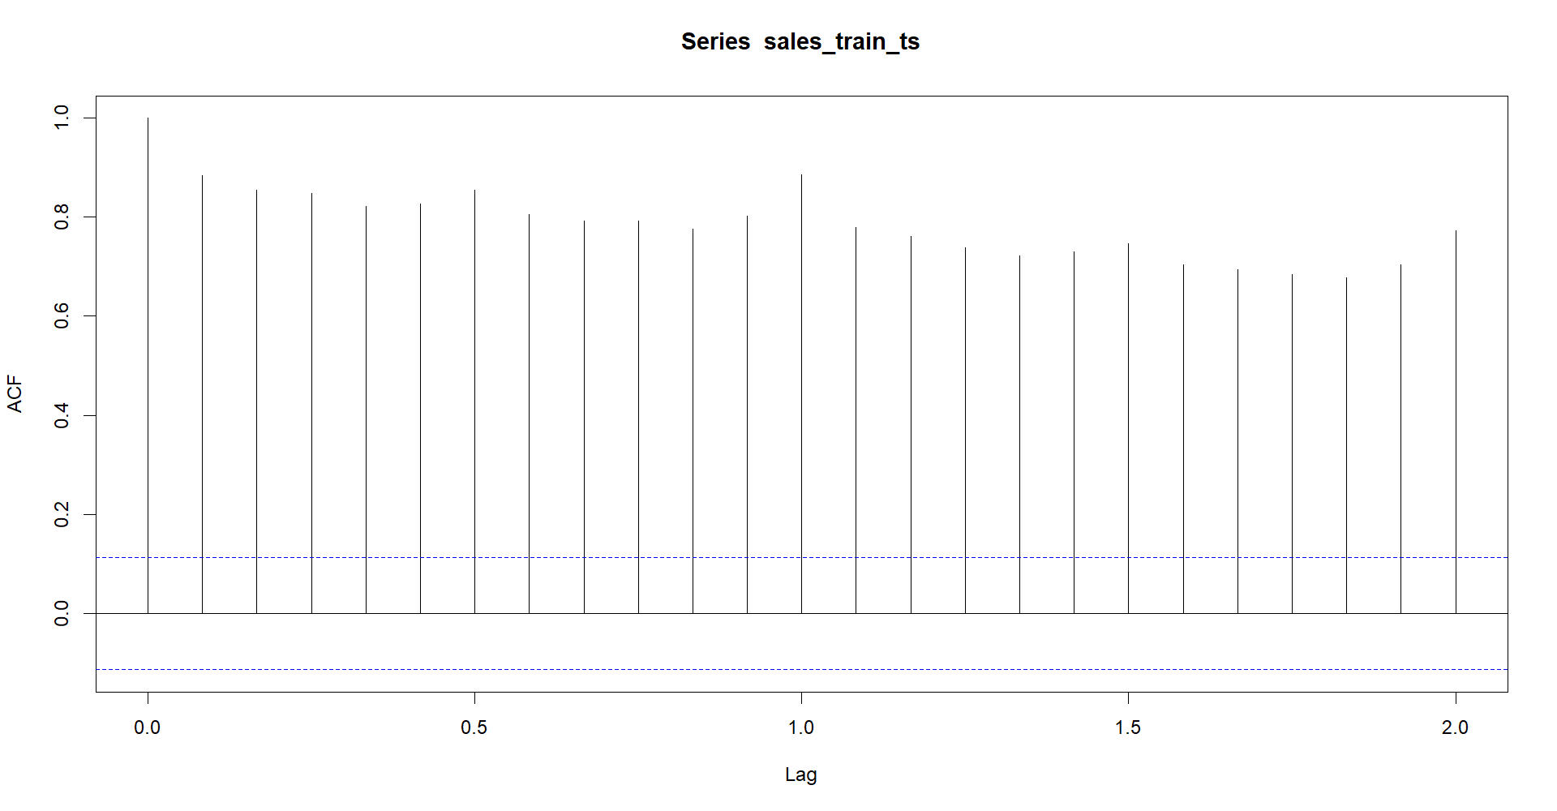
Autocorrelation

Slide 10
Autocorrelation
The partial autocorrelation function (PACF) compute the lag-k autocorrelation by removing the effects of lags 1 up to k-1.
So we are talking about a direct correlation between the time series and the lag-k, after eliminating the correlation between the same series and the lags 1, 2, 3 and so on, up to k – 1.

Slide 11
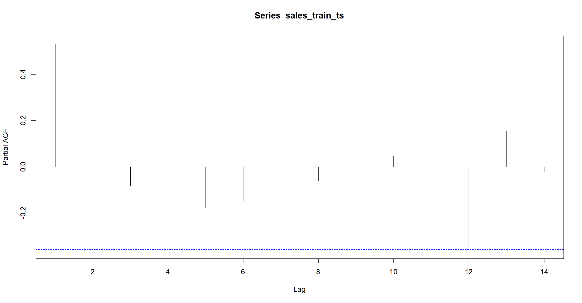
Autocorrelation

Slide 12
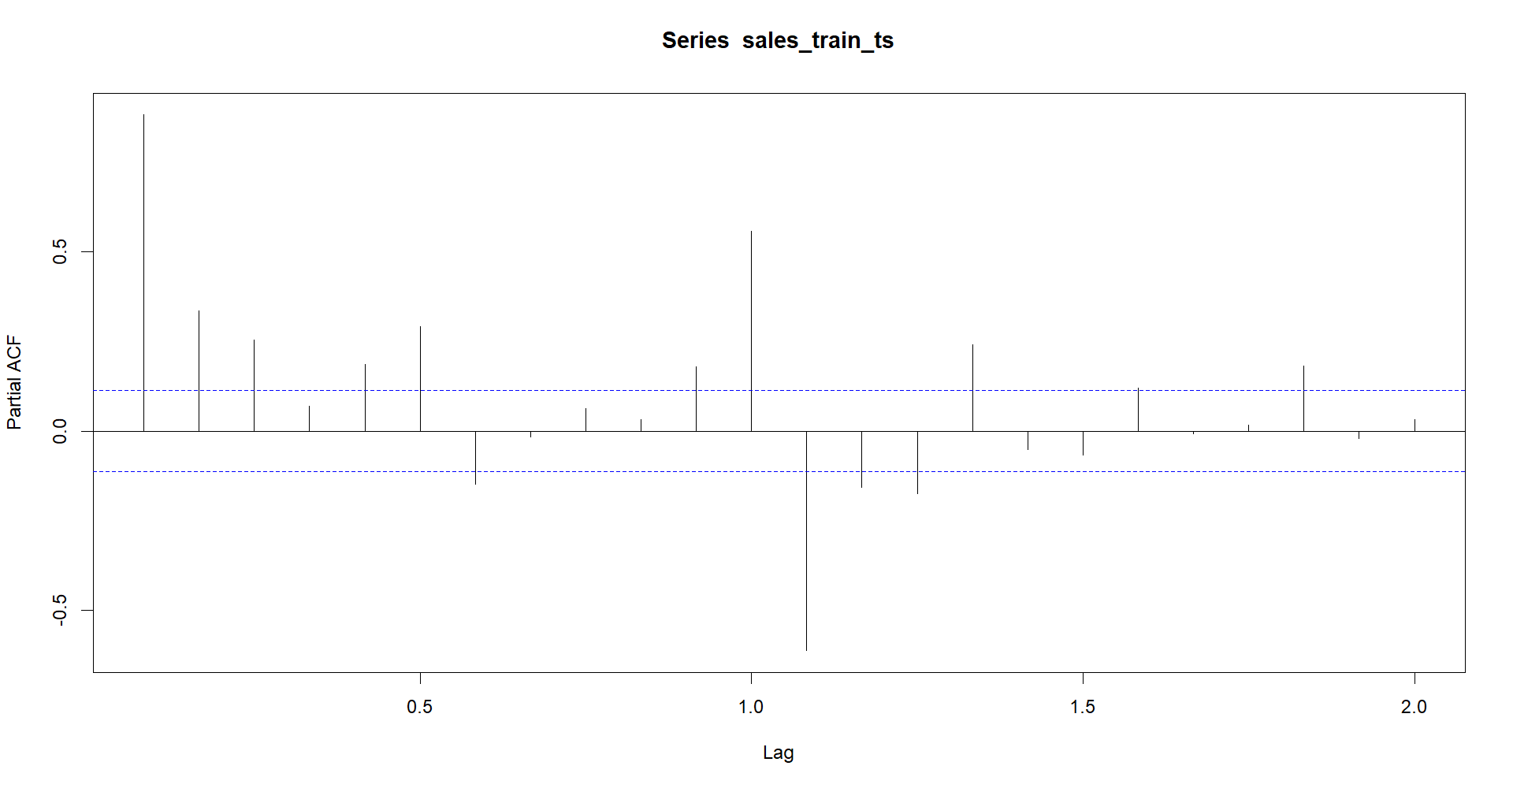
Autocorrelation

Slide 13
Stationarity

Slide 14
Stationarity
A stationary series is a series with the following property: its mean, variance and autocorrelation do not change over time.
So a stationary series does not have any trend or seasonality. Moreover, variance and autocorrelation are constant over time.

Slide 15
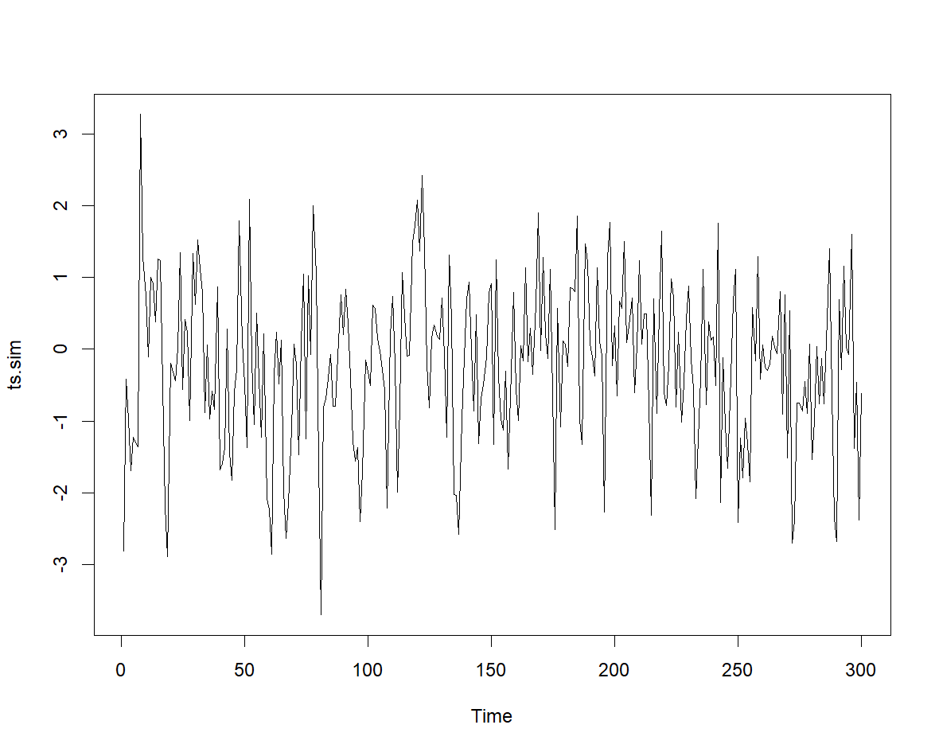
Stationarity

Slide 16
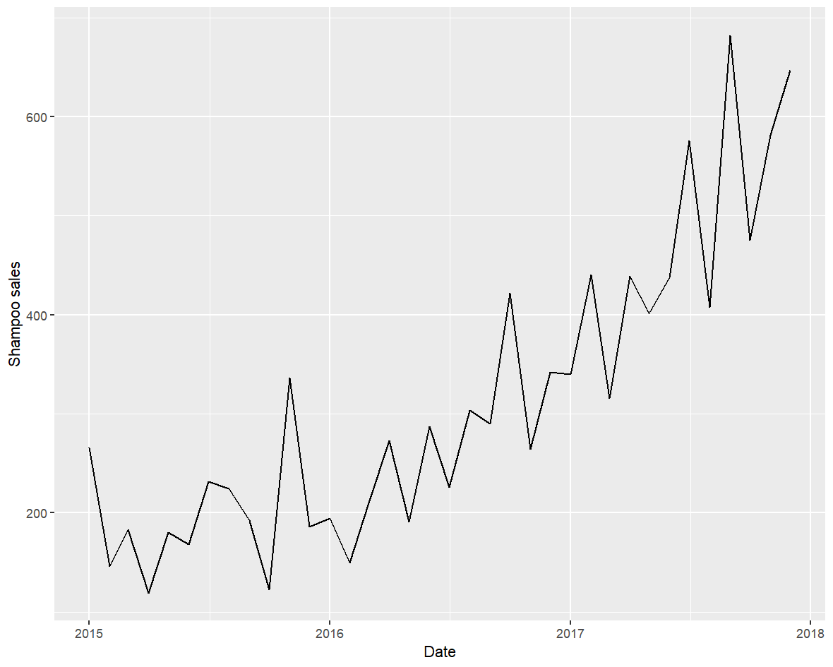
Stationarity

Slide 17
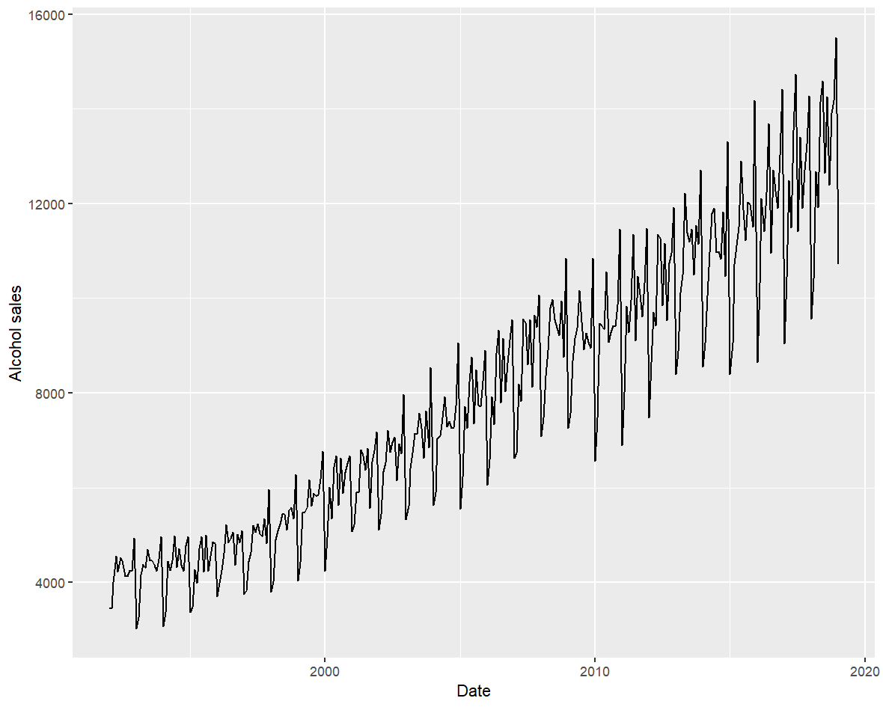
Stationarity

Slide 18
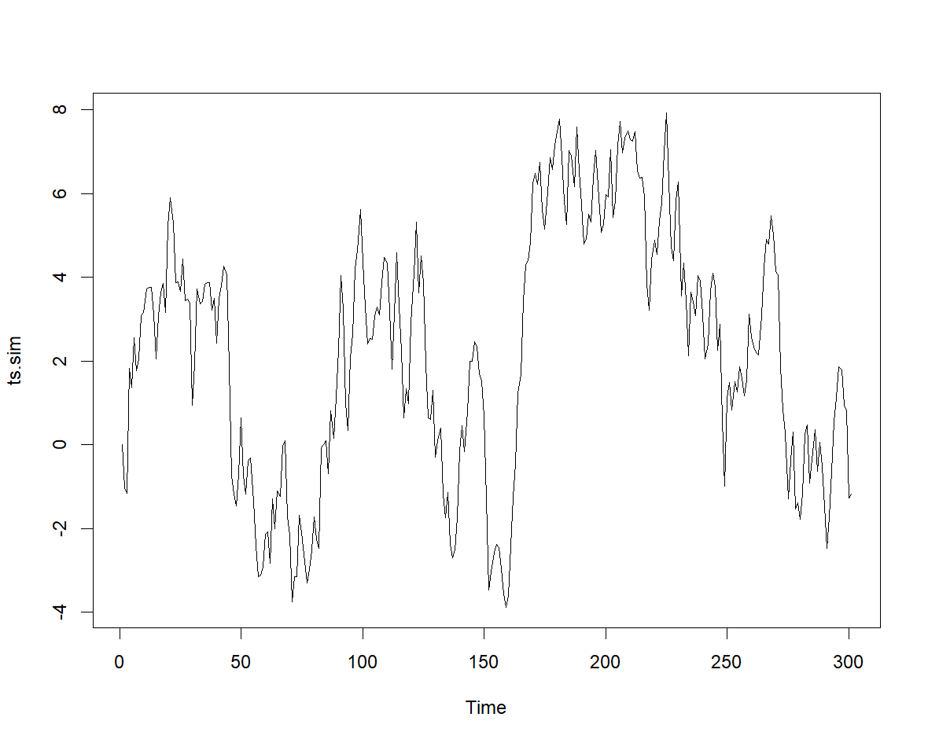
Stationarity

Slide 19
Stationarity
The first method to check stationarity: examine the plot.
If our series presents a dominant trend, or seasonal patterns, or big variations in the data values or variance, it is not stationary.

Slide 20
Stationarity
The second method (more precise): the augmented Dickey-Fuller test (aka unit root test).
H0: the series is non-stationary (explosive)
H1: the series is stationary
p < 0.05 - we reject the null hypothesis
p ≥ 0.05 – we accept the null hypothesis

Slide 21
Differencing

Slide 22
Differencing
The vast majority of the time series in the real world are non-stationary (there are very few exceptions).
Question: how can we convert a non-stationary series into a stationary one?

Slide 23
Differencing
Differencing (de-trending) means computing the differences between consecutive values in the series.
After de-trending, the mean of our time series stabilizes, becomes constant, so chances are our new time series is stationary.

Slide 24
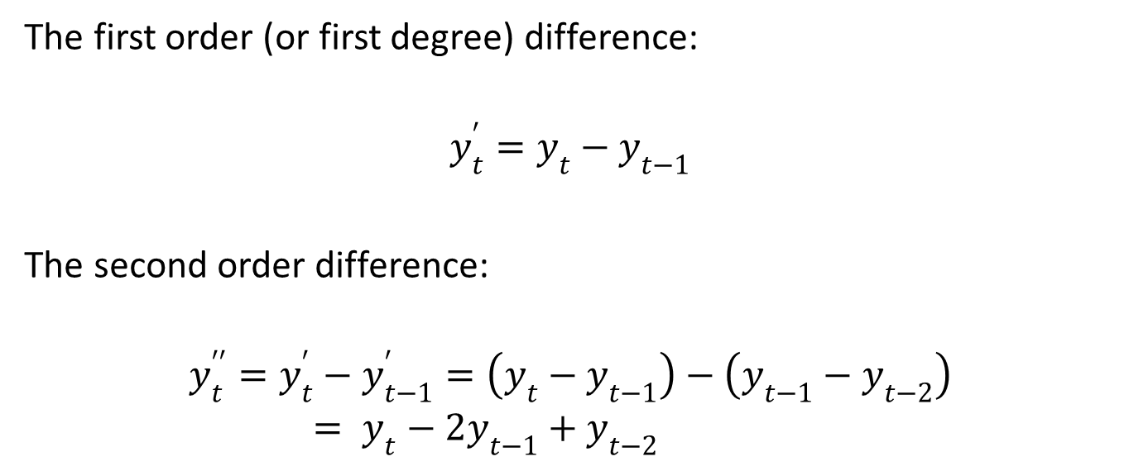
Differencing
The first order (or first degree) difference:
$$y_{t}^{′}=y_{t}−y_{t−1}$$
The second order difference:
$$y_{t}^{′′}=y_{t}^{′}−y_{t−1}^{′}=\left(y_{t}−y_{t−1}\right)−\left(y_{t−1}−y_{t−2}\right)= y_{t}−2y_{t−1}+y_{t−2}$$

Slide 25
Differencing
After each operation of differencing we can use the augmented Dickey-Fuller test to check stationarity.
Many time series become stationary after one or two differencing steps, at maximum.

Slide 26
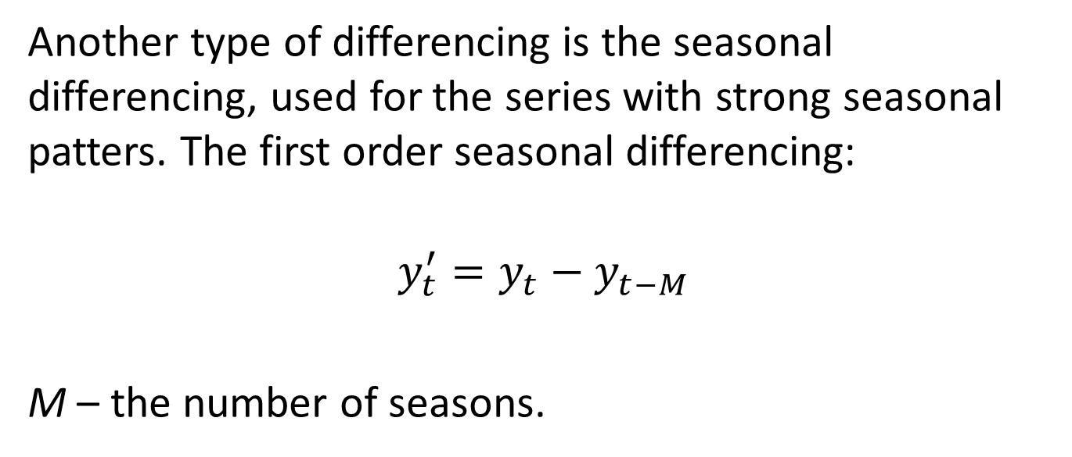
Differencing
Another type of differencing is the seasonal differencing, used for the series with strong seasonal patters. The first order seasonal differencing:
$$y_{t}^{′}=y_{t}−y_{t−M}$$
M – the number of seasons.

Slide 27
Differencing

Slide 28
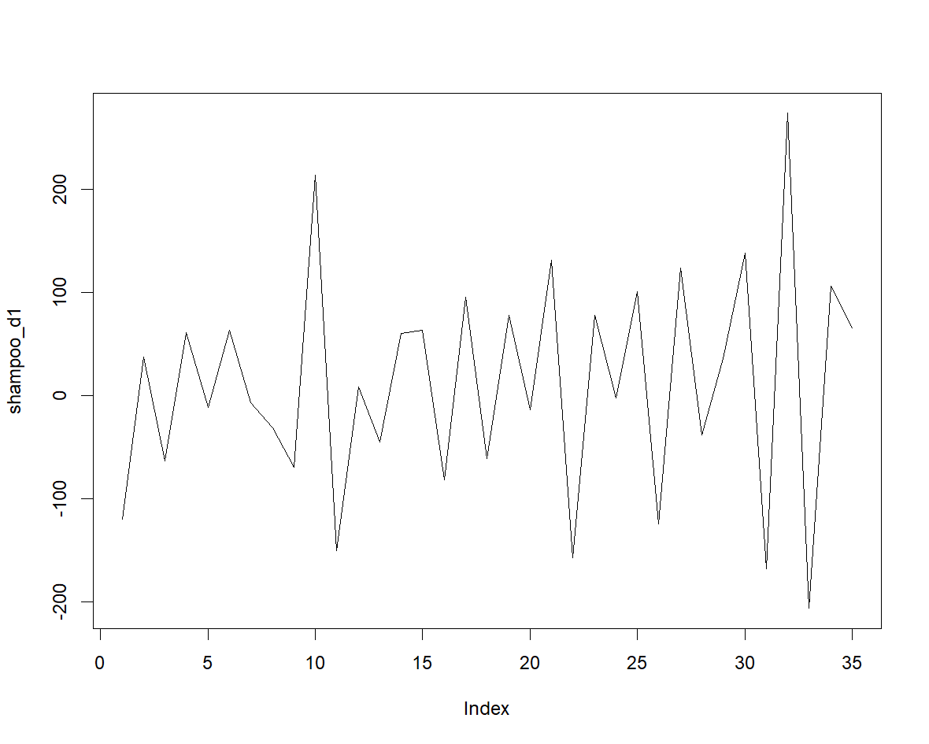
Differencing

Slide 29
Differencing

Slide 30
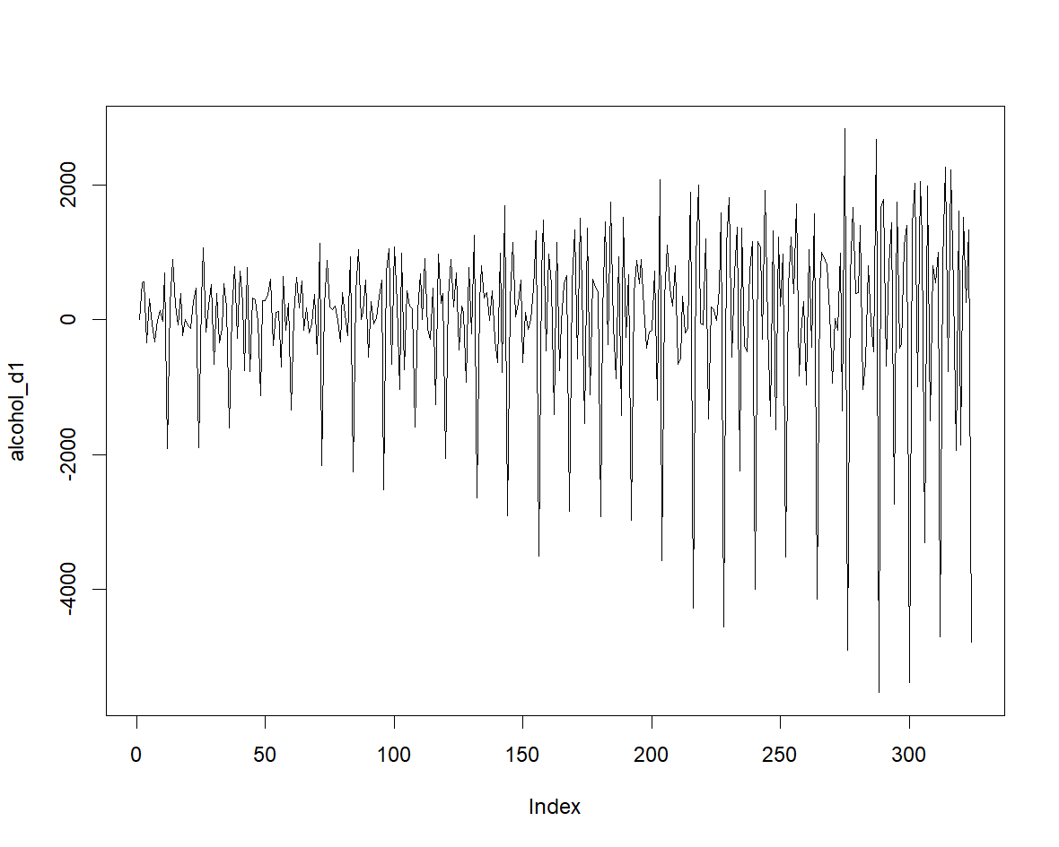
Differencing

Slide 31
Differencing
Before making the actual forecasts, we have to convert the stationary series back to the original series (the R program algorithms will do that for us automatically).

Slide 32
The AR Process

Slide 33
The AR process
A p order autoregressive (AR) process specifies the current values of the time series (y_{t}) as being a linear combination of the previous p lags.

Slide 34
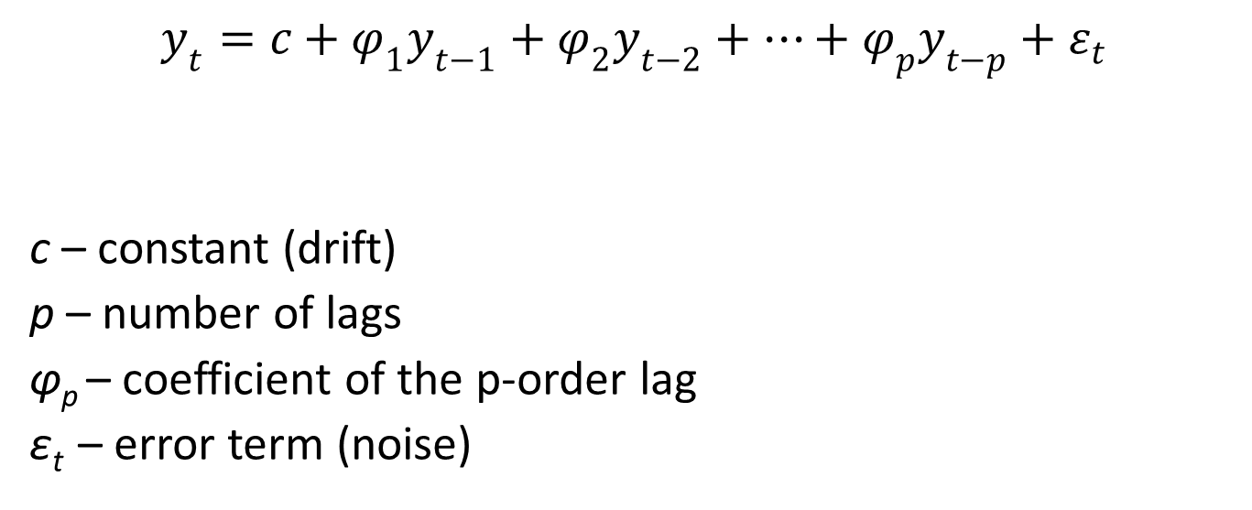
The AR process
$$y_{t}=c+φ_{1}y_{t−1}+φ_{2}y_{t−2}+…+φ_{p}y_{t−p}+ε_{t}$$
c – constant (drift)
p – number of lags
φ_{p} – coefficient of the p-order lag
ε_{t} – error term (noise)

Slide 35
The AR process
Very important: the AR process can be used only with stationary series. If our series is not stationary, we have to apply some transformation (for example, differencing) to convert it into a stationary one.
Also, the first coefficient of the equation above (φ₁) must be between -1 and 1; otherwise, the AR process will not be stationary.

Slide 36
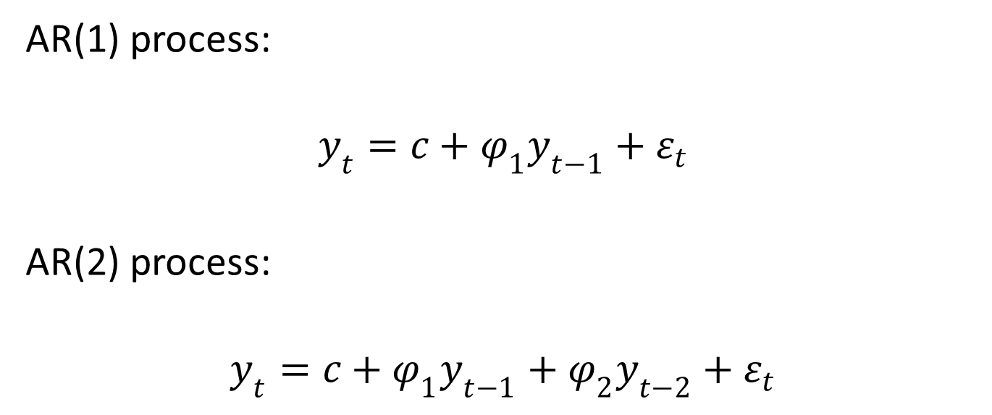
The AR process
AR(1) process:
$$y_{t}=c+φ_{1}y_{t−1}+ε_{t}$$
AR(2) process:
$$y_{t}=c+φ_{1}y_{t−1}+φ_{2}y_{t−2}+ε_{t}$$

Slide 37
The MA Process

Slide 38
The MA process
The moving average (MA) process is a class of models that define the current value of the time series (y_{t}) as a linear combination of the past error terms.

Slide 39
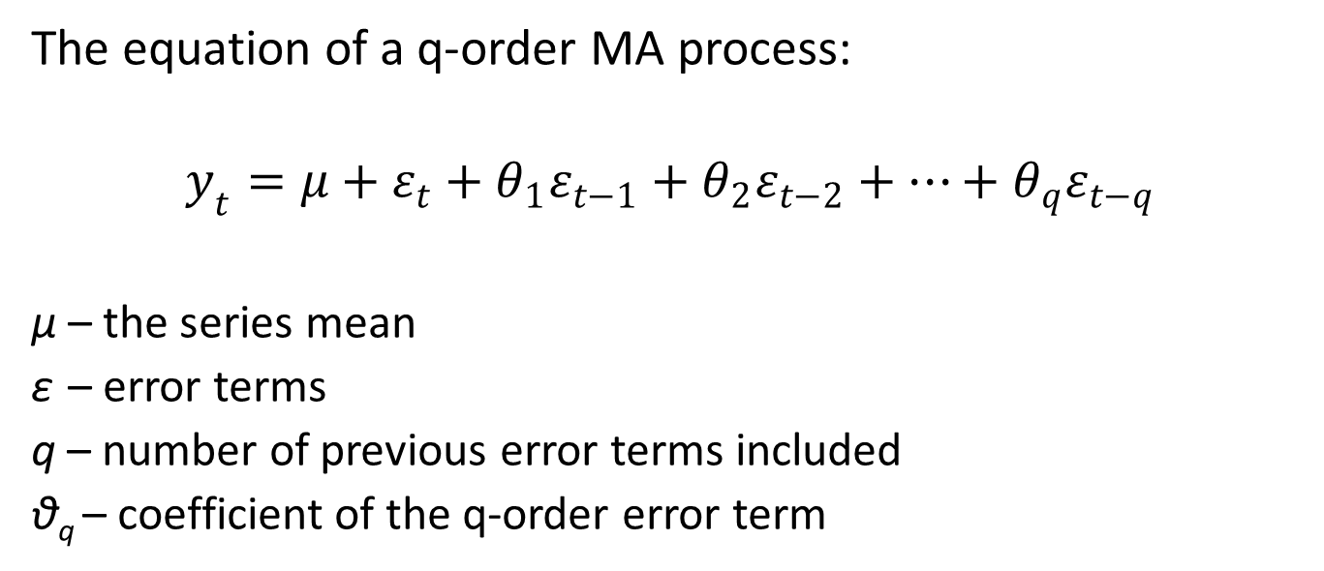
The MA process
The equation of a q-order MA process:
$$y_{t}=μ+ε_{t}+θ_{1}ε_{t−1}+θ_{2}ε_{t−2}+…+θ_{q}ε_{t−q}$$
μ – the series mean
ε – error terms
q – number of previous error terms included
θ_{q} – coefficient of the q-order error term

Slide 40
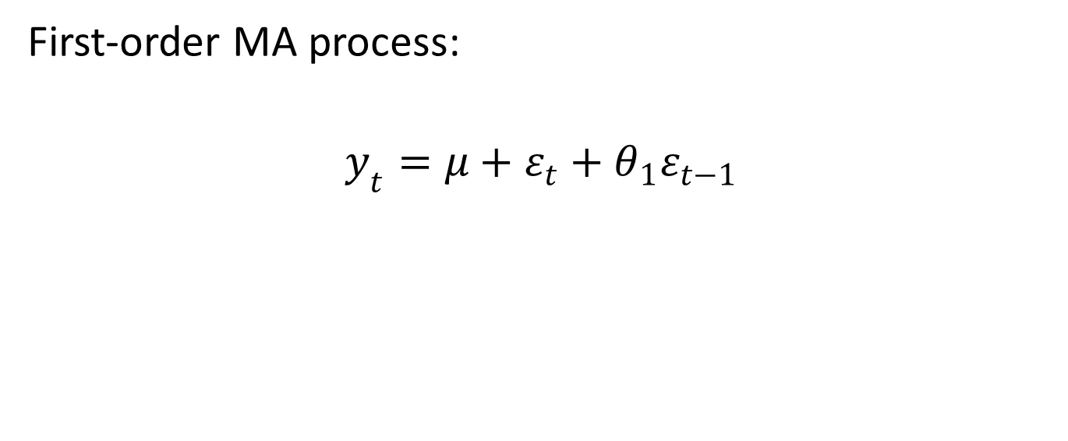
The MA process
First-order MA process:
$$y_{t}=μ+ε_{t}+θ_{1}ε_{t−1}$$

Slide 41
The MA process
A moving average model can be considered when our initial forecasting model does not catch all the series patterns adequately, and we suspect that some patterns are captured in the error terms.
(The moving average process should not be confused with the notion of moving average that we have learned in a previous section. It is a different concept.)

Slide 42
The MA process
Very important: the moving average process can be used only with stationary series. If our series is not stationary, we must convert it into a stationary one with differencing.

Slide 43
The MA process
Fitting a moving average model is more difficult, because the error terms are not observable. Some special iterative non-linear fitting methods are applied in this situation.

Slide 44
The ARMA Process

Slide 45
The ARMA process
In some situations, the autoregressive (AR) and moving average (MA) processes are combined, resulting a more complex model called ARMA. This combined model can help us make more accurate forecasts.
An ARMA process has two parameters:
p – the number of lags used in the AR model
q – the number of error terms that appear in the MA model

Slide 46
The ARMA process
The ARMA model can be used only when our time series is stationary.

Slide 47
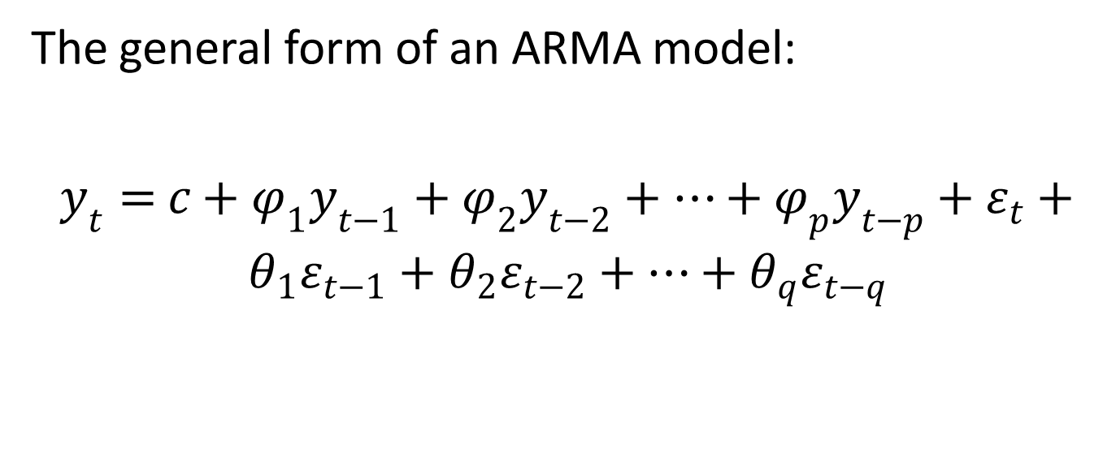
The ARMA process
The general form of an ARMA model:
$y_{t}=$ $c+φ_{1}y_{t−1}+φ_{2}y_{t−2}+…+φ_{p}y_{t−p}+ε_{t}+θ_{1}ε_{t−1}+θ_{2}ε_{t−2}+…+θ_{q}ε_{t−q}$

Slide 48
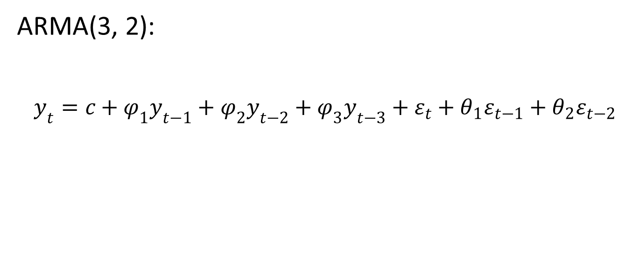
The ARMA process
ARMA(3, 2):
$$y_{t}=c+φ_{1}y_{t−1}+φ_{2}y_{t−2}+φ_{3}y_{t−3}+ε_{t}+θ_{1}ε_{t−1}+θ_{2}ε_{t−2}$$

Slide 49
The ARIMA Process

Slide 50
The ARIMA process
The autoregressive (AR) and moving average (MA) models have a strict limitation: they cannot handle non-stationary series.

Slide 51
The ARIMA process
If our time series is non-stationary, we have to add a so-called integrated process to our ARMA model.
This process is nothing but differencing the series with its lagged variables. What we get is an ARIMA model, which stands for AutoRegressive Integrated Moving Average.

Slide 52
The ARIMA process
An ARIMA model has 3 parameters:
p – the number of lags used in the AR model
d – the degree of integration (differencing)
q – the number of error terms that appear in the MA model

Slide 53
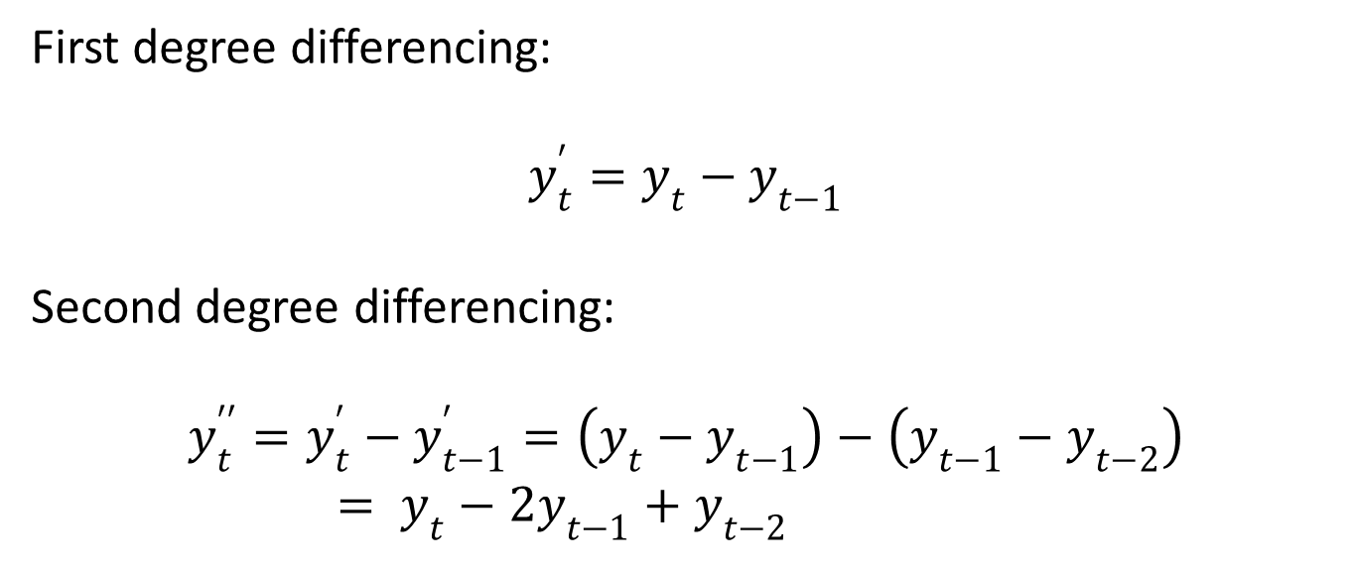
The ARIMA process
First degree differencing:
$$y_{t}^{′}=y_{t}−y_{t−1}$$
Second degree differencing:
$$y_{t}^{′′}=y_{t}^{′}−y_{t−1}^{′}=\left(y_{t}−y_{t−1}\right)−\left(y_{t−1}−y_{t−2}\right)= y_{t}−2y_{t−1}+y_{t−2}$$

Slide 54
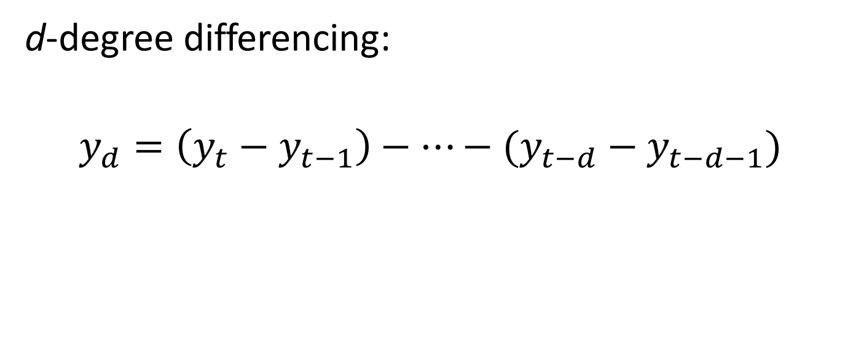
The ARIMA process
d-degree differencing:
$$y_{d}=\left(y_{t}−y_{t−1}\right)−…−(y_{t−d}−y_{t−d−1})$$

Slide 55
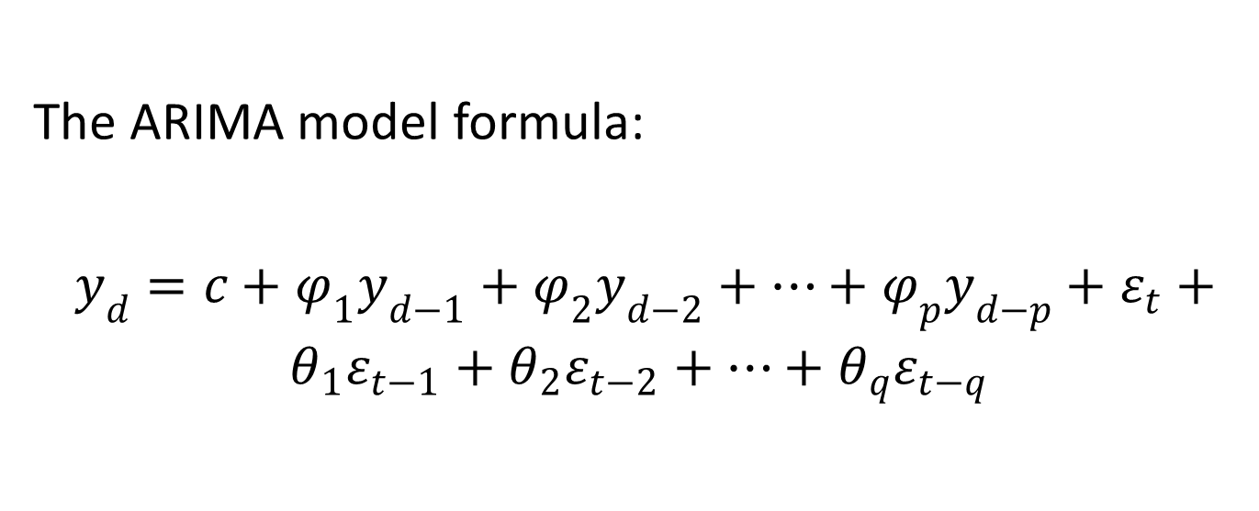
The ARIMA process
The ARIMA model formula:
$y_{d}=c+φ_{1}y_{d−1}+φ_{2}y_{d−2}+…+φ_{p}y_{d−p}+ε_{t}+θ_{1}ε_{t−1}+θ_{2}ε_{t−2}+…+θ_{q}ε_{t−q}$

Slide 56
The ARIMA process
For example, an ARIMA(3, 1, 2) model comprises:
a 3-order AR process (using three lags)
a 1-degree integrated process (i.e. 1-degree differencing)
a 2-order MA process (using two error terms)

Slide 57
The ARIMA process
The AR, MA and ARMA processes can be defined as particular cases of the ARIMA process:
an AR(p) process is equivalent to an ARIMA(p, 0, 0) process
an MA(q) process is equivalent to an ARIMA(0, 0, q) process
an ARMA(p, q) process is equivalent to an ARIMA(p, 0, q) process

Slide 58
Identifying the ARIMA Model

Slide 59
Identifying the ARIMA model
Before running any ARIMA model we must specify the model parameters: p, d and q.
In other words, we must identify the model.

Slide 60
Identifying the ARIMA model
Model identification is usually a two-step process:
Find out the degree of differencing necessary to get a stationary series. This will be the d parameter. For example, if one degree differencing is enough to convert our series into a stationary one, then d will be set to one.
Specify the other two parameters: p, i.e. the order of the AR process and q, i.e. the order of the MA process.

Slide 61
Identifying the ARIMA model
Choosing the p and q parameters is not straightforward. We must examine the ACF and PACF charts and make some decisions based on how these charts look.
Many times we have to try several combinations of parameters (several models) in order to identify the most effective one.

Slide 62
Identifying the ARIMA model
To identify the order of the AR process (the p parameter) we have to look at the PACF chart (partial autocorrelation function).

Slide 63
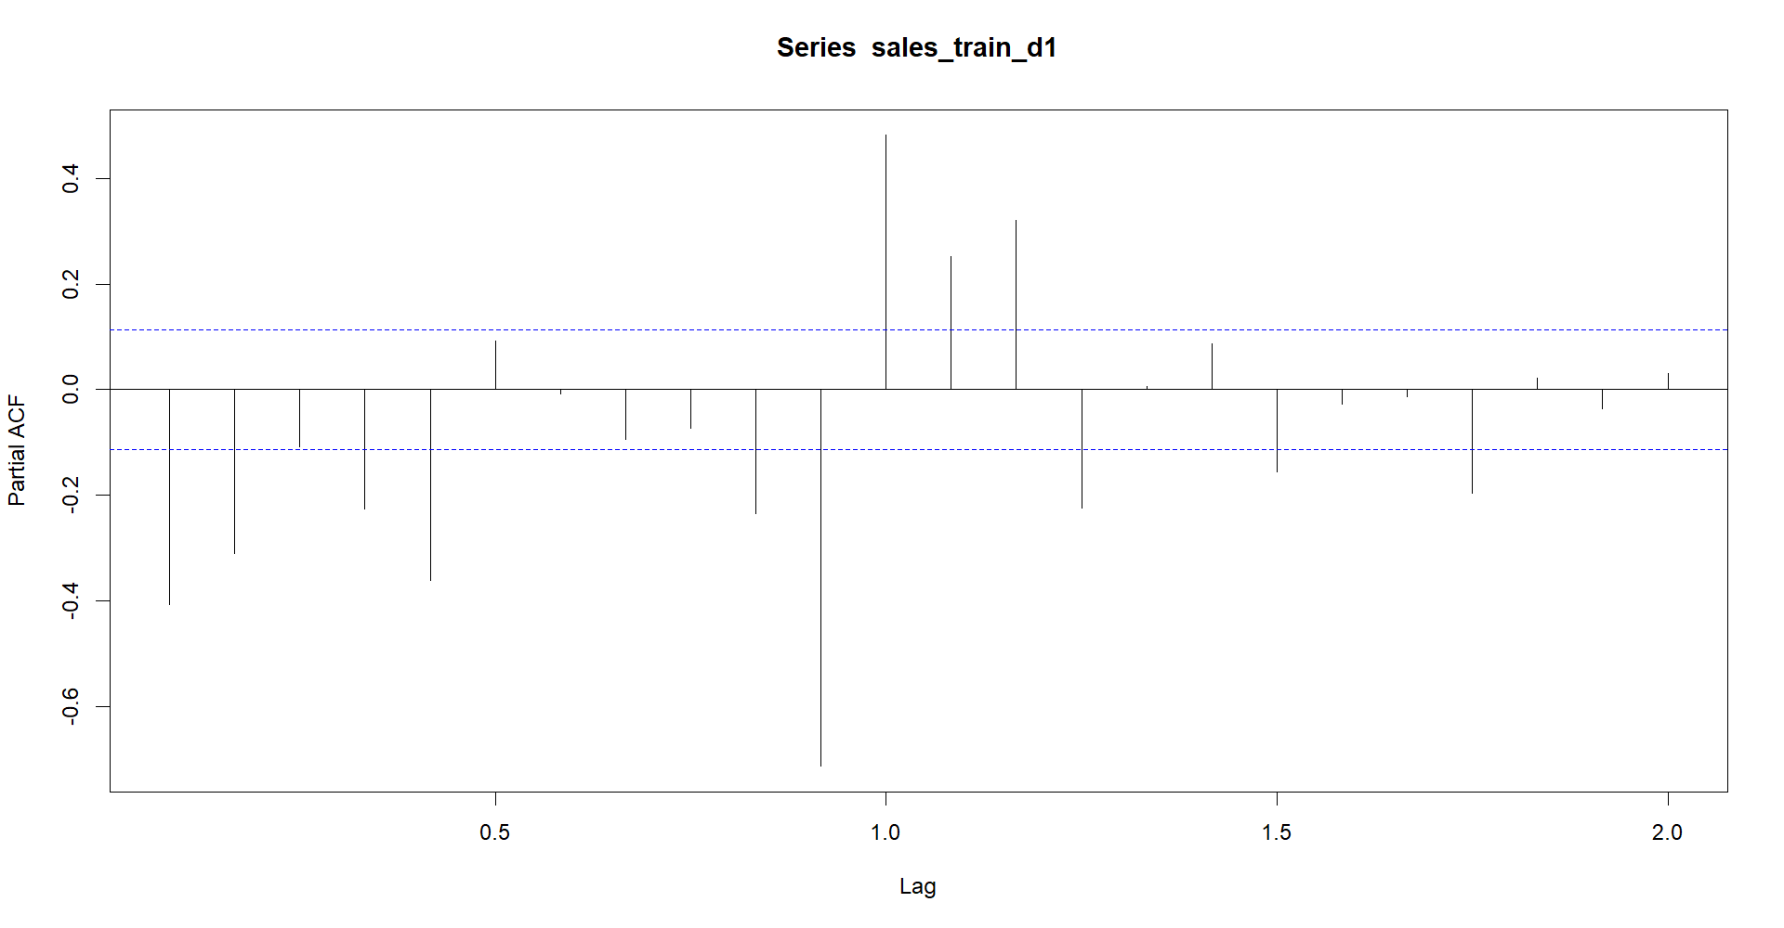
Identifying the ARIMA model

Slide 64
Identifying the ARIMA model
To identify the order of the MA process (the q parameter) we have to look at the ACF chart (autocorrelation function).

Slide 65
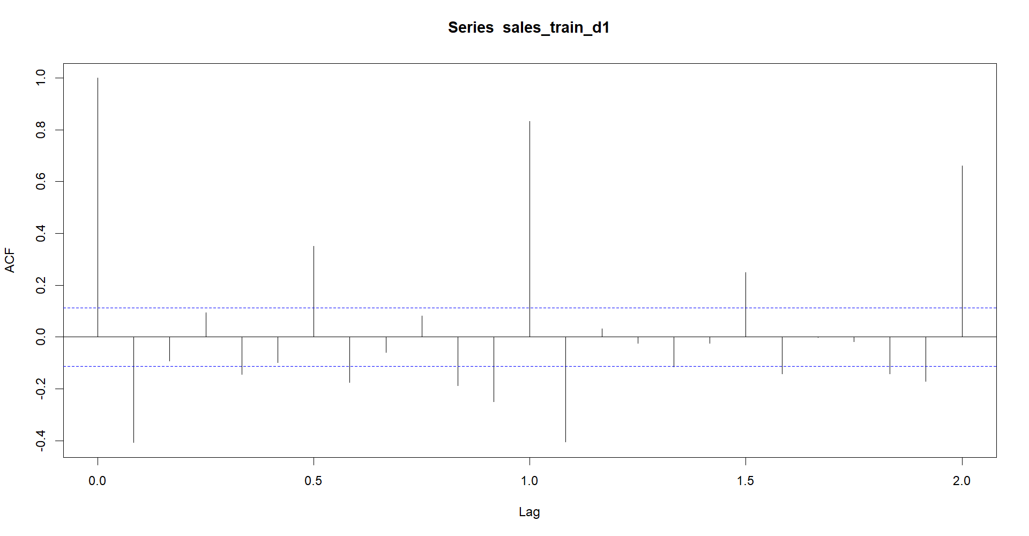
Identifying the ARIMA model

Slide 66
Identifying the ARIMA model
Strategy to identify the best model:
First, choose greater values for the parameters p and q. Then run your model and see how it performs.
If the forecast accuracy in the test set is good, reduce the values of p and q in order to try simpler models.
Finally, choose the simplest model that provides satisfactory forecasting accuracy levels.

